Slide 1
Progress_uPDATE_0 (IOT_Security)
Submitted to:
Dr. Hassan Mostafa

Slide 2
Agenda
Progress update for the Thesis IOT security topic
Next Steps
References

Slide 3
Status update for the Thesis progress → LAST MEETING Findings
After the kick off meeting , two main ideas were the points of next survey :
Idea 1
Checking the possibility of a low power cryptography algoirthm for IOT
Aspect of change can be at any (or more) of the following points:
Algorithm itself (AES , RSA, or any lightweight cryptography)
RTL Change
HW and platform
Idea 2
Measurment criteria or security measure for an encrypted message
The main implementation idea is the algorithm for decrypting the incomming message
Output of the system were supposed to be : (secure measure , and time taken to decrypt)

Slide 4
Status update for the Thesis progress
Idea 1 findings:
Paper 1:
Different security algorithms were implemented (ASIC) design [AES , 3DES , Twofish , and RSA]
Implementation was based on 130 nm technology.
AES 256 has proved a very good results in terms of power and area.
Paper 2:
AES 128 implementation based on iterative looping and pipelining.
Implementation was based on Virtex 5 FPGA.
Paper 3
Efficient FPGA based implementation of Rijndael Encryption
Targets an efficient implementation and optimization schemes of AES for FPGAs
Implementation was based on Virtex 5 FPGA.

Slide 5
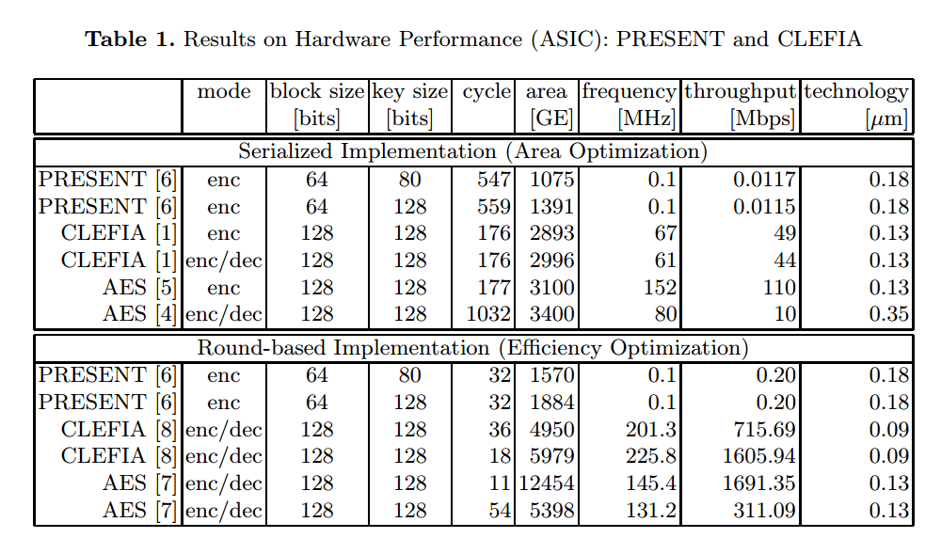
Status update for the Thesis progress
Paper 4
Compact and efficient encryption and decryption module for AES
Implementation was based on Spartan 3 FPGA
Main objective of the design was a low area constraints.
Paper 5
Design of AES cryptography using co-processor idea.
Implementation was based on TSMC 65 nm technology.
The coprocessor incorporates local data and instruction memory to save BW when integrated with SoC.
Paper 6
Implementation of Lightweight cryptography algorithm idea.
To the , a table shows different results for CLEFIA algorithms
(which is a lightweight crypt. algorithm)

Slide 6
Status update for the Thesis progress
Paper 7
Hardware low power implementation of Attribute based encryption (ABE)
Implementation was based on Spartan 3E FPGA
(ABE) is a novel privacy-preservation encryption approach that changes its key according to user attributes and a policy between these attributes.
Paper 8
Due to the deducible key rounds in AES and it leads to security problems. As a result, a new algorithm for generation of round keys is developed for AES.
Implementation was based on FPGA for (AES-128)
Main idea was to enhance the security of AES algorithm by enhancing key generation approach
Notes:
Paper 7: These attributes can be the user’s e-mail, IP address, etc. This paper proposes the usage of ABE for securing Internet of Things (IoT) networks

Slide 7
Status update for the Thesis progress
Idea 2 findings:
Major Paper (paper 9):
Main work is extracting the original message of an encrypted DES algorithm.
Implementation was based on Virtex II pro.
Output was extracting the original message keys and extracting the original message itself.

Slide 8
Status update for the Thesis progress
The Idea that i have chosen to do further research on it is:
Idea 1 , Mainly due to:
Availability of many research work and papers
More than one area for research
Algorithm itself
Algorithm enhancements
HW level optimization
Also for the second idea , the current work is not enough and seems more complicated in terms of data availability

Slide 9
Next Steps
Identifying the major point and aspect of research:
Chosing the algorithm itself (Lightweight , AES , ABE , or something else)
Single or coprocessor based encryption idea
Chosing whether Optimizing on (RTL Level, algorithm level, ..etc)
Hardware that i have bought and intending initially to do the research and simulation on it is :
Beagle Bone Black Rev C + LOGI bone Cape (please see next slides)

Slide 10
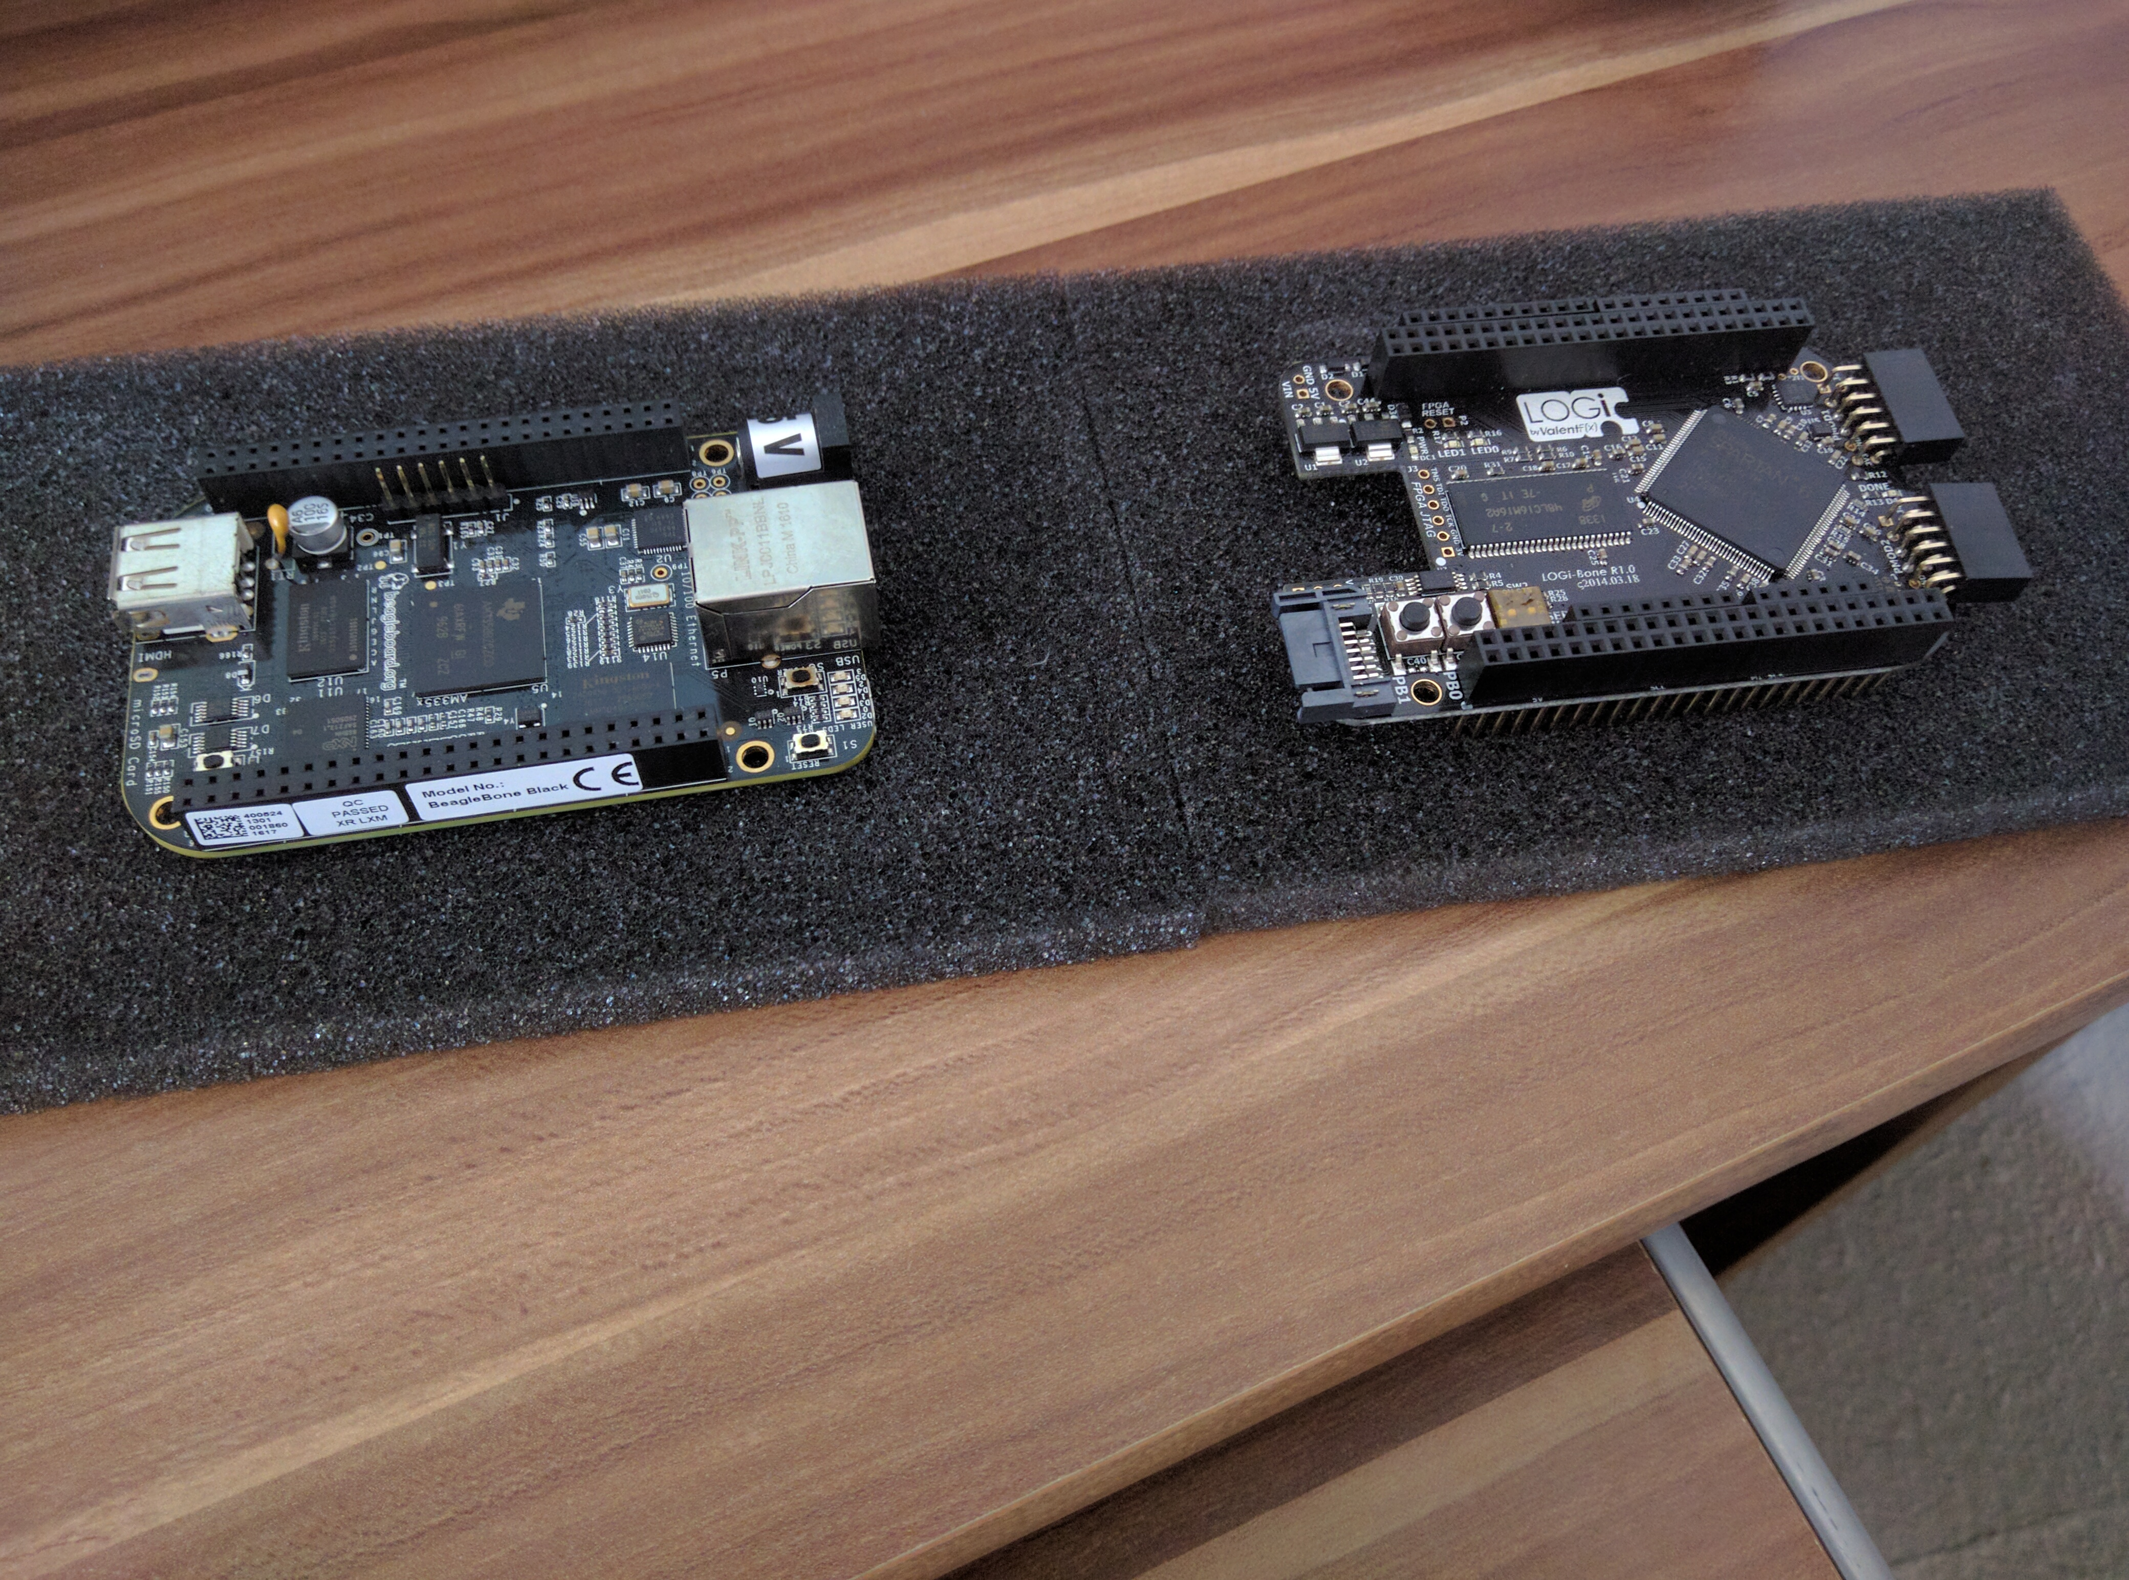
BEAGLE BONE BLACK + LOGI BONE (a side)
Beaglbone Black Rev C
LogiBone
AM3358 1GHz ARM® Cortex-A8 Processor
512MB DDR3 RAM
4GB 8-bit eMMC Onboard Flash
3D Graphics Accelerator
NEON Floating-Point Accelerator
2x PRU 32-bit Microcontroller
Connectivity:
USB Client for power and communications
USB Host
Ethernet , Micro HDMI
2x 46-pin Headers
Software Compatibility
* Angstrom Linux * Android * Debian
* Ubuntu * Cloud9 IDE on Node.js with BoneScript
FPGA: Spartan 6 LX9 – TQFP144 Package - XC6SLX9-2TQG144C
Plug and play interfacing the BeagleBone
LOGI Stack of firmware, drivers and so to make interfacing to the FPGA easy
Arduino Shield expansion allowing for more than 200 existing plug in hardware modules
Pmod compatible headers allowing for more than 50 existing low cost hardware modules
4 layer optimized design to support maximum performance of high bandwidth applications
Length tuned GPMC, SDRAM and LVDS signals for high performance applications
50 Mhz MEMS oscillator
Notes:
LOGI BONE Peripherals
2x Push buttons
2x DIP Switch
1x High bandwidth LVDS connector expansion port
32 FPGA IO available through Pmod and Arduino headers
2x Digilent Inc. Pmod ports supporting 59+ plug and play hardware modules
1x Arduino Header supporting 200+ Arduino Shield modules
Optional I2C, SPI access from the BeagleBone
10x LVDS pairs routed as: 100 ohm differential, 50 ohm single-ended
256 Mb SDRAM

Slide 11
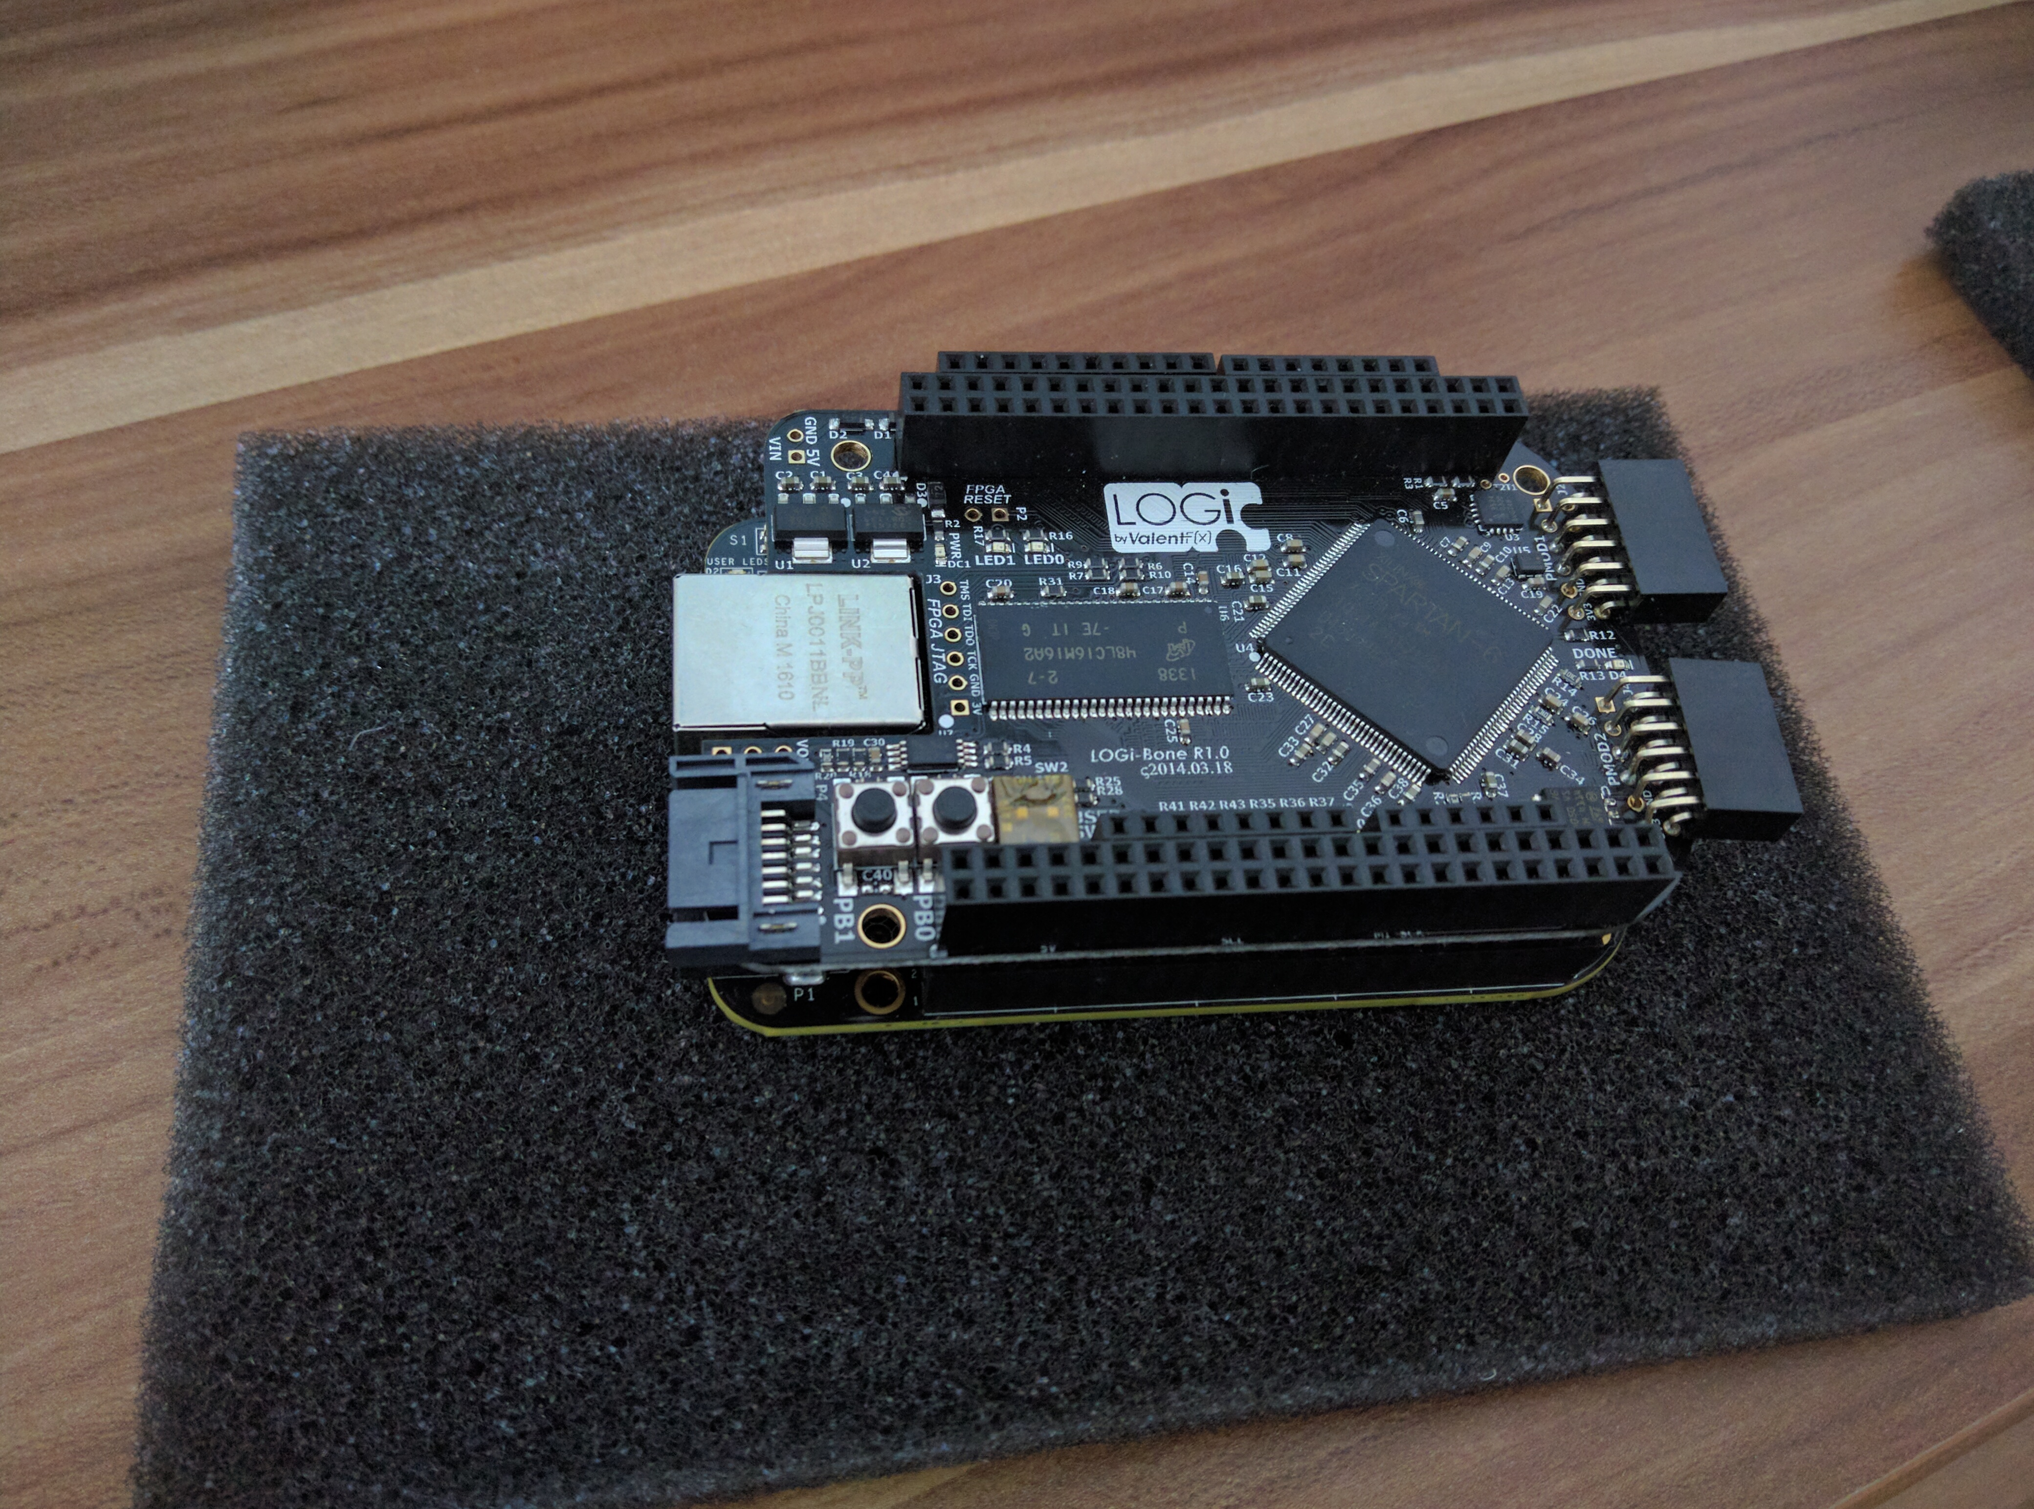
BEAGLE BONE BLACK + LOGI BONE (connected)

Slide 12
References
Paper 1: ASIC-Oriented Comparative Review of Hardware Security Algorithms for Internet of Things Applications
Paper 2: Efficient Implementation of the AES Algorithm for Security Applications
Paper 3: Efficient Implementation of Rijndael Encryption in Reconfigurable Hardware: Improvements and Design Tradeoffs
Paper 4: Compact and Efficient Encryption/Decryption Module for FPGA Implementation of the AES Rijndael Very Well Suited for Small Embedded Applications
Paper 5: Cryptographic Coprocessor design for IOT sensor nodes
Paper 6: Lightweight Cryptography for the Internet of Things
Paper 7: Hardware Low Power implementation of Attribute Based Encryption
Paper 8: FPGA Implementation of Enhanced Key Expansion Algorithm for Advanced Encryption Standard
Paper 9: On the Vulnerability of FPGA Bitstream Encryption against Power Analysis Attacks

Slide 13
Thank You , Any Questions ?

